Slide 1
Statistics 367-1-4361 — Lecture 10
Frequentist Methods, Part 1
Opher Donchin

Slide 2

Time for Kahoot!
Notes:
It's Kahoot time! Join us for a fun and interactive quiz session. Test your knowledge, compete with your peers, and see who can top the leaderboard. Don't miss out on the excitement and prizes. Grab your devices and get ready to play!

Slide 3
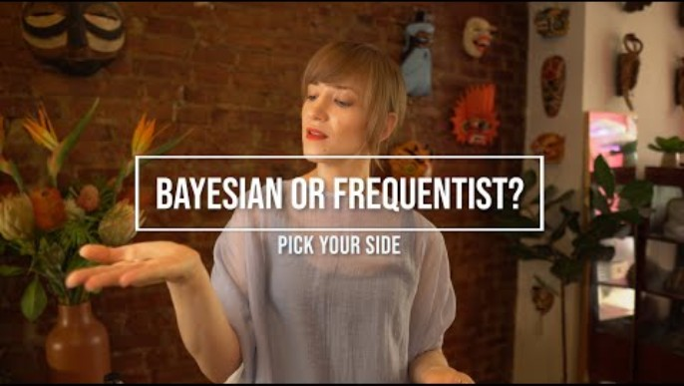
Bayesianism vs Frequentism

Slide 4
8A Review of Bayesian Framing

Slide 5
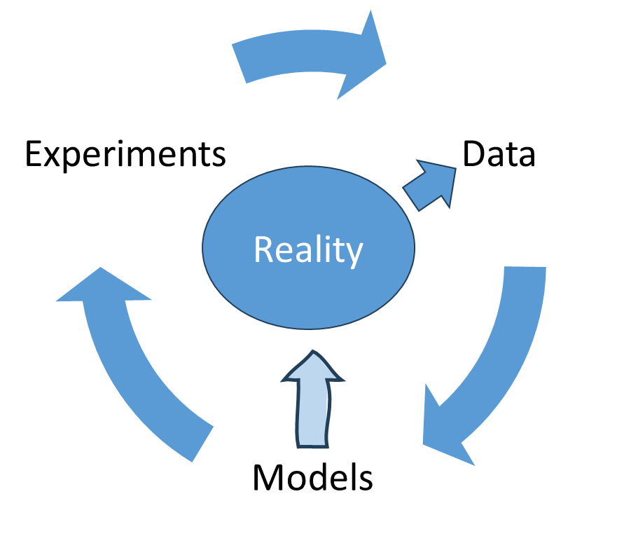
The Bayesian View
Understanding reality is an iterative process
Each step builds on the last
Models can only approximate reality
Models tell us what we can learn from the data
Also what we can’t learn:
They show what data we need

Slide 6
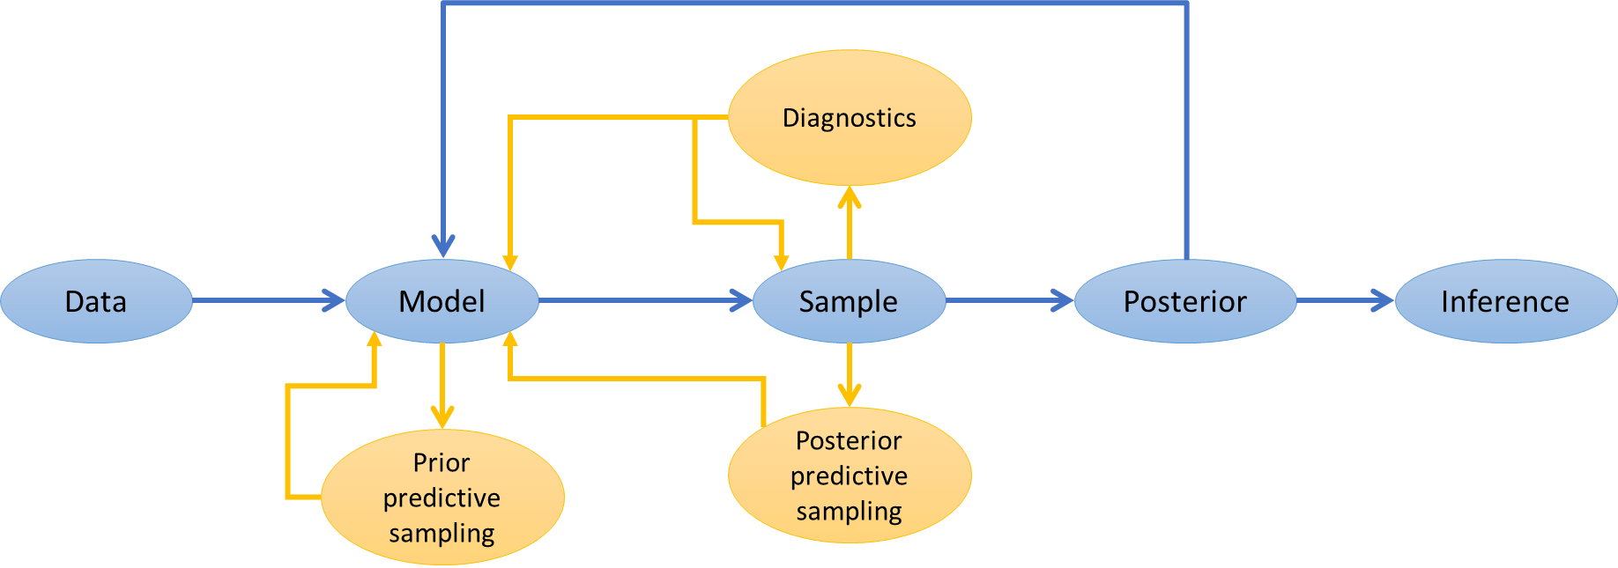
Bayesian Workflow
What model works for this data?
Does it make sense?
Does it work, technically?
Does it fit the data?
What can we learn from it?
What other models might make sense?
Which is best?
In what way?

Slide 7
The Bayesian philosophy
Data tells us about the world
It updates our understanding
Models express our knowledge
Probability distributions over parameters express uncertainty
Bayesian updating combines knowledge with new information
Models are a convenience
They can be critiqued, replaced, or updated

Slide 8
8A Frequentist Framing

Slide 9
Frequentist philosophy
The goal is to uncover truths
Truths describe an objective reality
Independent of observers
Characterized by parameters
Real-world constants

Slide 10
Frequentist philosophy
The goal is to uncover truths
Truths describe an objective reality
Uncertainty arises from real-world stochasticity
Probability describes this real-world stochasticity
Real-world stochasticity creates data variability
Structural uncertainty is outside the scope
Model uncertainty
Model mismatch
Measurement reliability and validity

Slide 11
Frequentist philosophy
The goal is to uncover truths
Truths describe an objective reality
Uncertainty arises from real-world stochasticity
The method is rational and objective
Rationality requires objectivity
Methods independent of who is applying them
Decision criteria general and set in advance

Slide 12
Frequentist philosophy
The goal is to uncover truths
Truths describe an objective reality
Uncertainty arises from real-world stochasticity
The method is rational and objective
Rationality requires objectivity
Rational is to minimize the chance of error
Because being in error is not uncovering truth

Slide 13
Frequentist emphasis
Estimation
What is my best guess about the truth?
My best guess of the true value of the parameter
Hypothesis testing
Can I rule out certain possibilities?
Parameter values I can rule out

Slide 14
Bayesian vs Frequentist
Bayesian
Frequentist
Parameters are random variables
Their distribution represents our uncertainty
Parameters are constants
Which we are trying to estimate

Slide 15
Bayesian vs Frequentist
Bayesian
Frequentist
Parameters are random variables
Data is constant
It is given
Parameters are constants
Data are random variables
This randomness creates parameter uncertainty

Slide 16
Bayesian vs Frequentist
Bayesian
Frequentist
Parameters are random variables
Data is constant
Models are provisional
Procedures lead to posteriors
Goal: characterize uncertainty
Parameters are constants
Data are random variables
Models are fixed by procedures
Procedures lead to decisions
Goal: minimize error in saying what is true

Slide 17
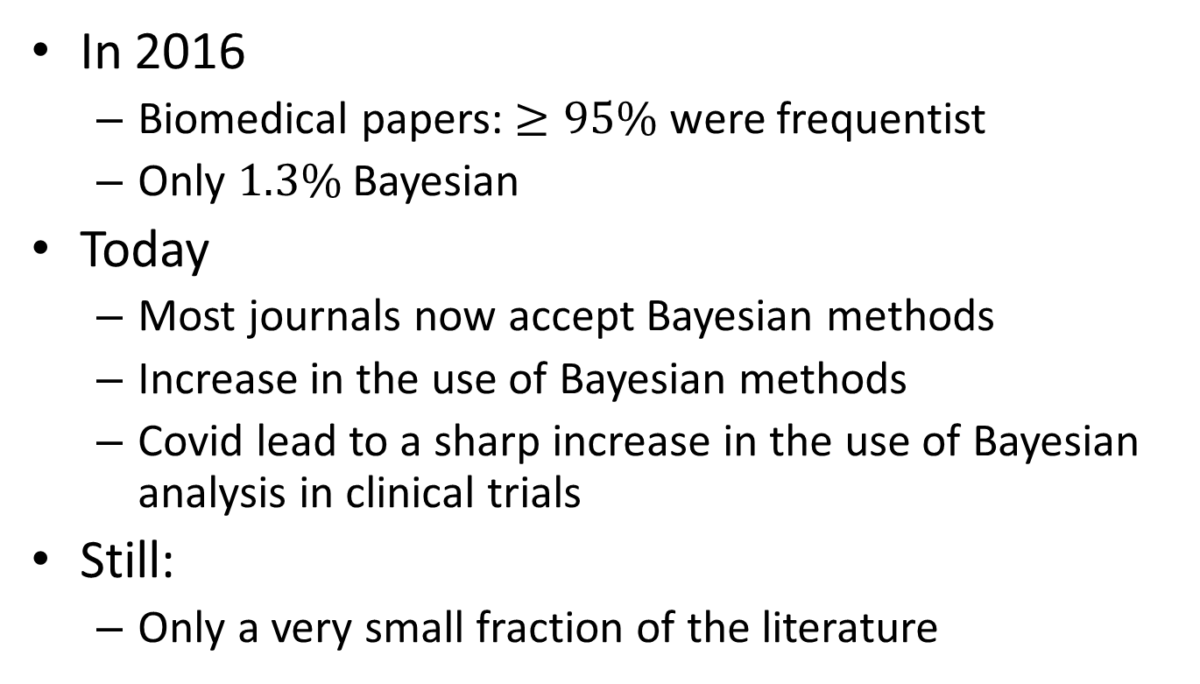
Frequentist dominance in biomedical publishing
In 2016
Biomedical papers: $≥95\%$ were frequentist
Only $1.3\%$ Bayesian
Today
Most journals now accept Bayesian methods
Increase in the use of Bayesian methods
Covid lead to a sharp increase in the use of Bayesian analysis in clinical trials
Still:
Only a very small fraction of the literature

Slide 18
8C Frequentist estimators

Slide 19
Different kinds of estimators
Estimation principles
Minimum variance, unbiased estimator (MVUE)
Maximum likelihood estimation (MLE)
Method of moments estimation (MME)
Best linear unbiased estimator (BLUE)

Slide 20
Different kinds of estimators
Principled estimators
MVUE, MLE, MME, BLUE
Robust estimators
Rank based estimation (R-estimators)
Linear combinations of rank (L-estimators)

Slide 21
Different kinds of estimators
Principled estimators
MVUE, MLE, MME, BLUE
Robust estimators
R-estimators, L-estimators
Regularized estimators
Ridge regression
Lasso regression
James-Stein estimation

Slide 22
Different kinds of estimators
Principled estimators
MVUE, MLE, MME, BLUE
Robust estimators
R-estimators, L-estimators
Regularized estimators
Ridge, Lasso, James-Stein estimation
Every estimator has assumptions
Remember application not justification
Check assumptions before using

Slide 23
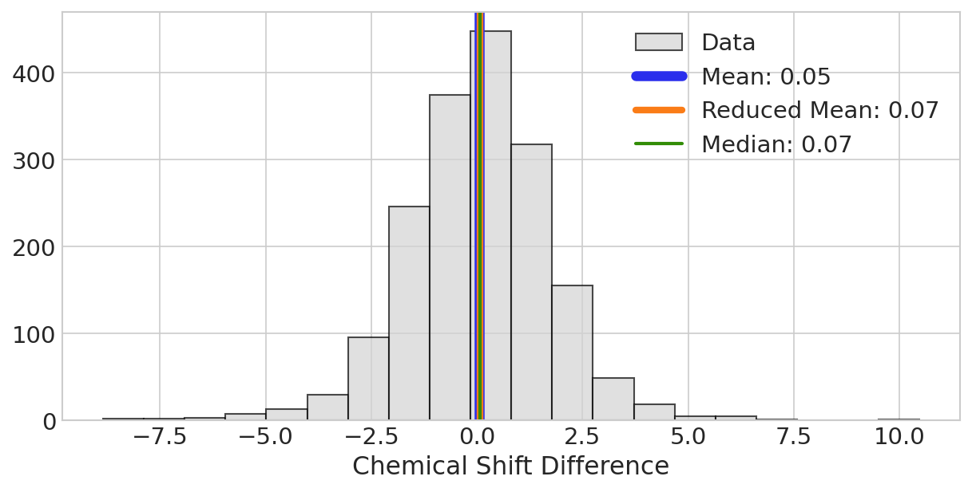
Comparing estimators of the mean
The sample mean
The MLE and MVUE if the population is normal
Sensitive to outliers
The sample median
Variable but not sensitive to outliers
The trimmed mean
A compromise
Calculate without 20% of outlying data

Slide 24
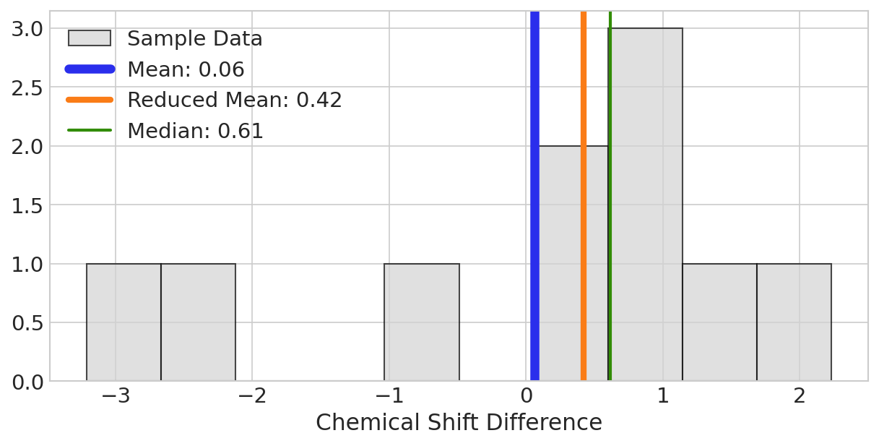
Estimating the mean on small samples
Differences become substantial for small data sets
Or with large outliers

Slide 25
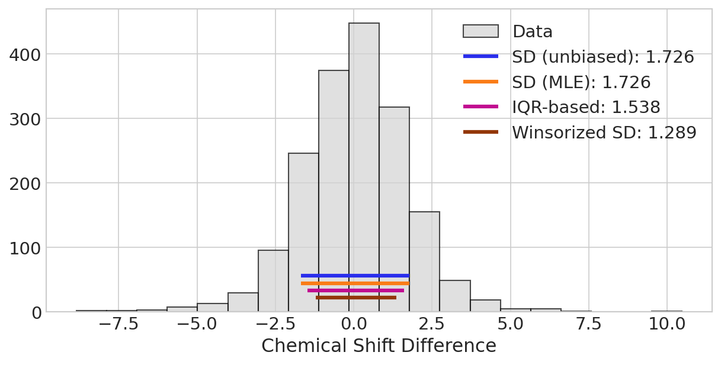
Estimators of the standard deviation
The sample standard deviation
The MVUE if the population is normal
Sensitive to outliers
The MLE
Biased but lower variance
IQR-based
Useful if data is not normally distributed
Winsorized
Data trimmed
Parameter pairs:
Sample standard devation / sample mean
MLE / sample mean
IQR-based / median
Winsorized / trimmed mean

Slide 26
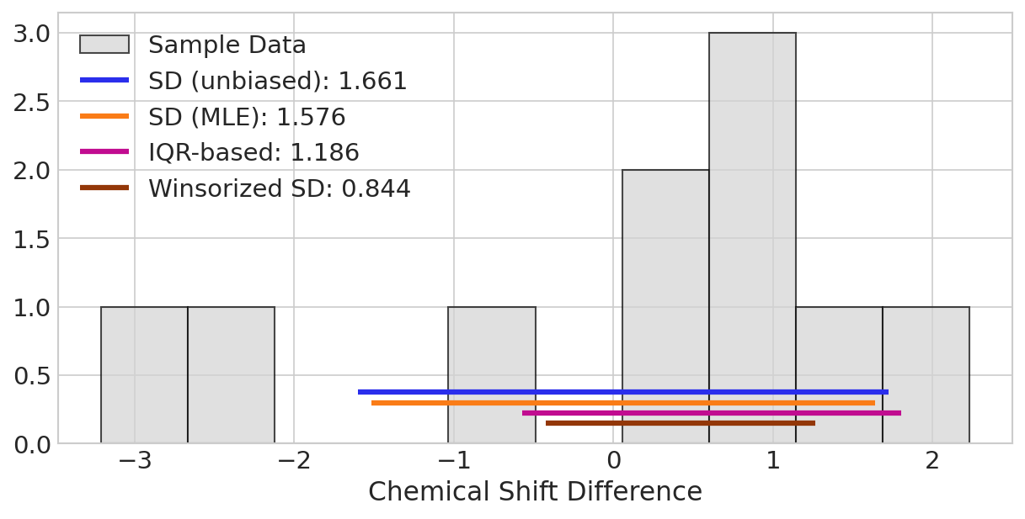
Standard deviation of small samples

Slide 27
8D Maximum Likelihood Estimation (MLE)

Slide 28
What is the MLE?
MLE is the mode of the likelihood
Requires a model
Model + derivative
Analytic solution
Model + gradient descent
Computational solution
Why MLE?
The parameter that makes our data easiest to believe

Slide 29
Why the MLE?
Advantages
Disadvantages
Consistency
Converges to the true value
Efficiency
Minimum variance
Flexibility
Works with complex models
Sensitive to:
Model misspecification
Outliers
Computationally complex

Slide 30
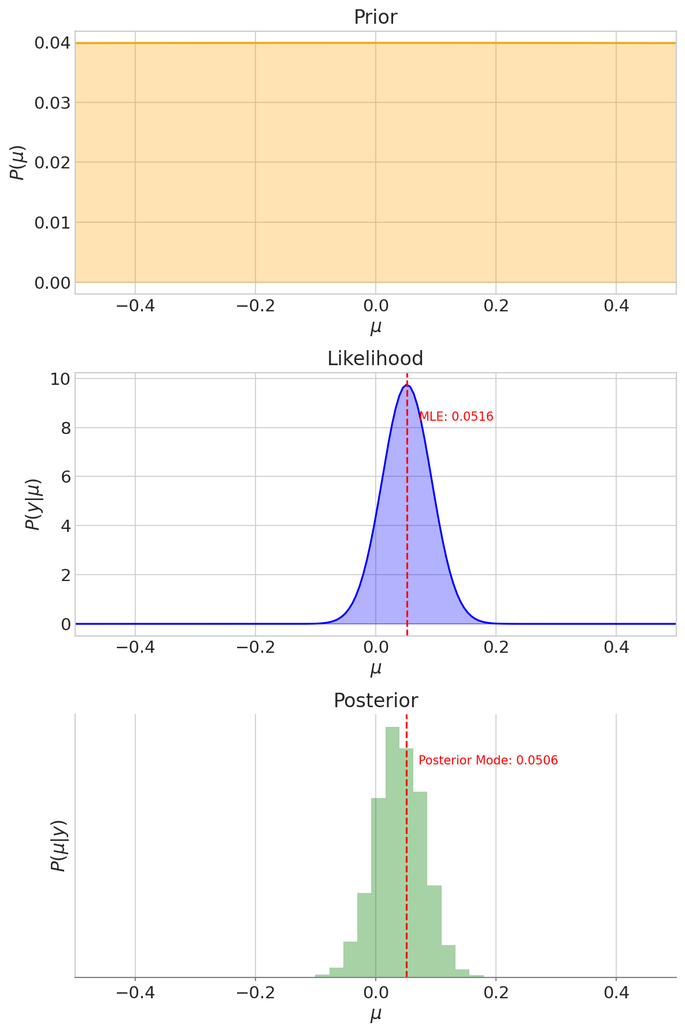
MLE from the Bayesian perspective
Maximum of the posterior
When the prior is flat

Slide 31
Two ways to get MLE
Analytic
Take the derivative of the likelihood and solve for 0
Many useful likelihoods have analytic MLE estimators of parameters
Numerically
With complex likelihoods
Use gradient descent or other maximization algorithm
Generally faster than MCMC

Slide 32
8E The Sampling Distribution

Slide 33
The sampling distribution
The sampling distribution is the distribution of an estimator
Sample + Measure
Distribution of
the estimator
Universe
Sample + Measure
Sample + Measure
Sample + Measure

Slide 34
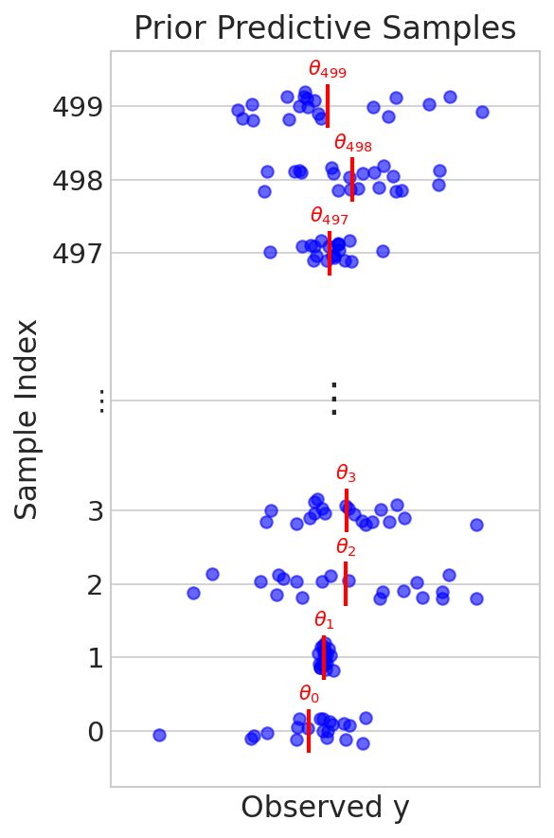
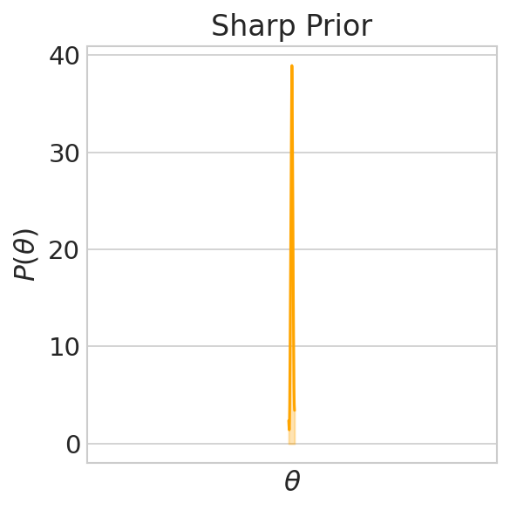
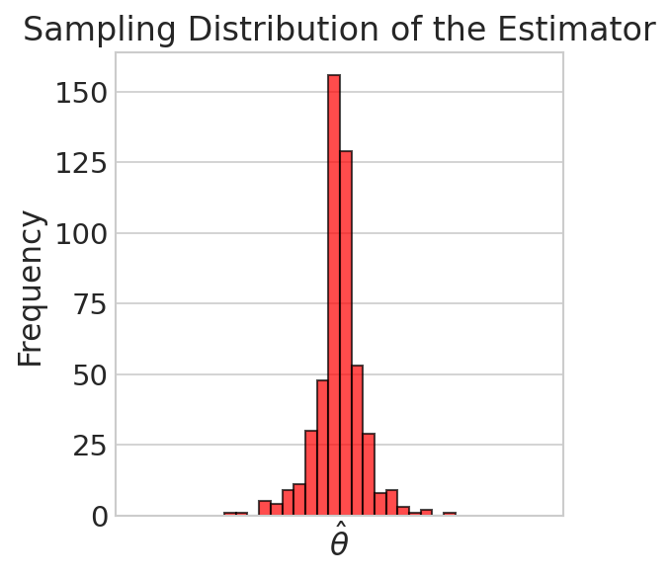
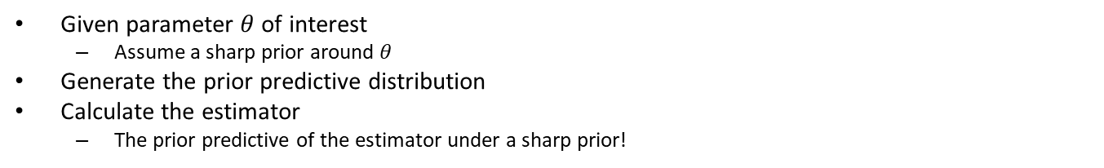
Prior predictive under sharp priors
Given parameter $θ$ of interest
Assume a sharp prior around $θ$
Generate the prior predictive distribution
Calculate the estimator
The prior predictive of the estimator under a sharp prior!

Slide 35
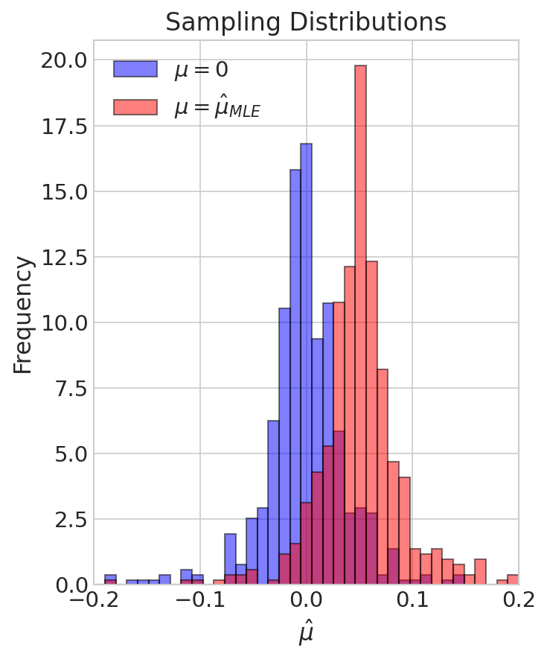
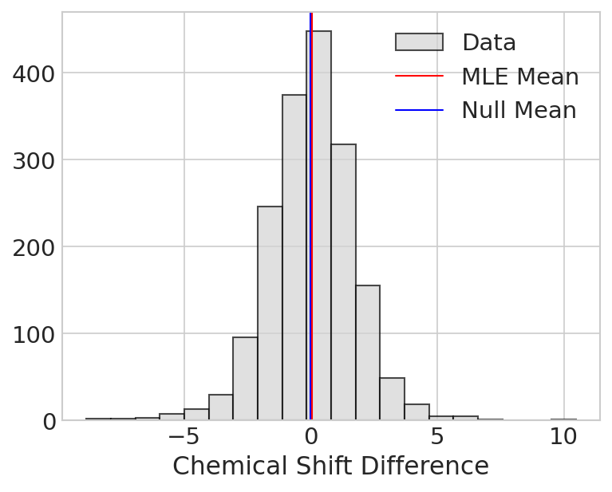
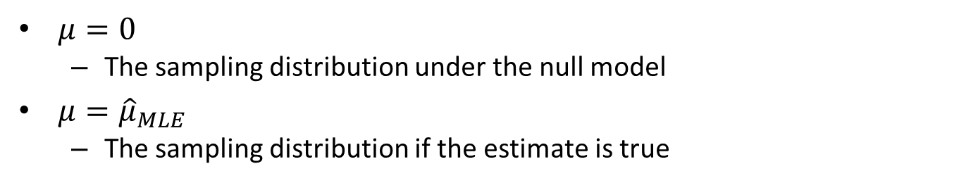
Two important sampling distributions
$μ=0$
The sampling distribution under the null model
$μ={\hat{μ}}_{MLE}$
The sampling distribution if the estimate is true

Slide 36
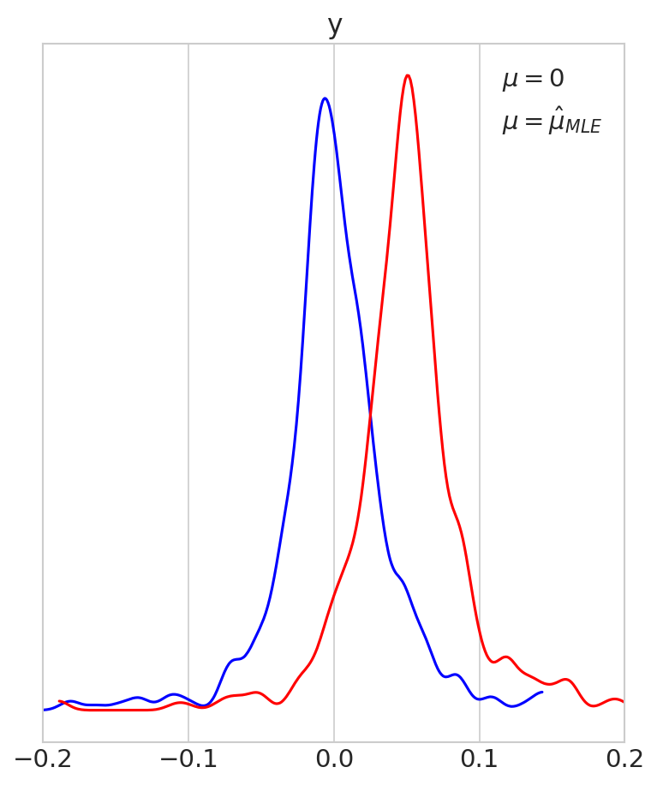
Using plot_bpv to get the sampling distribution
az.plot_bpv(prior_pred_null, kind='t_stat', t_stat='mean', group='prior')
az.plot_bpv(prior_pred_mle, kind='t_stat', t_stat='mean', group='prior)

Slide 37
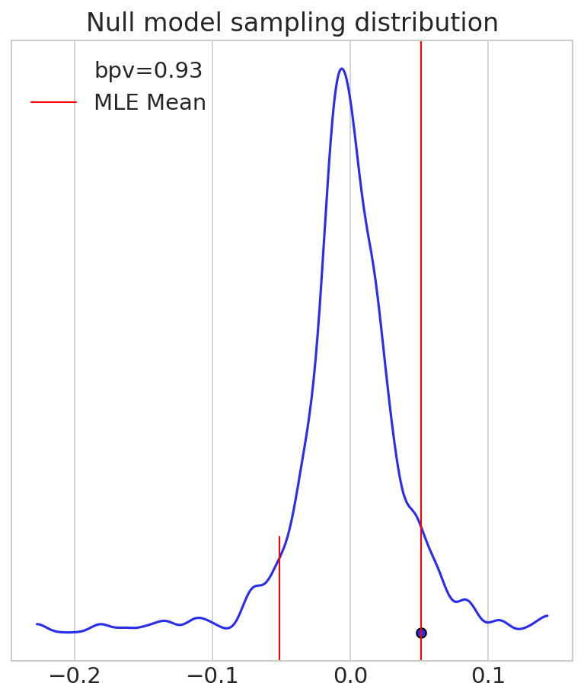
Sampling distributions for hypothesis testing
How easily could we get our data if null model is true?
If null model is true and we repeat experiment
How often will sample mean be further from 0 than my sample mean?
Consider positive and negative values
Called the frequentist p value
Or just the p value
If p<0.05, reject the null model

Slide 38
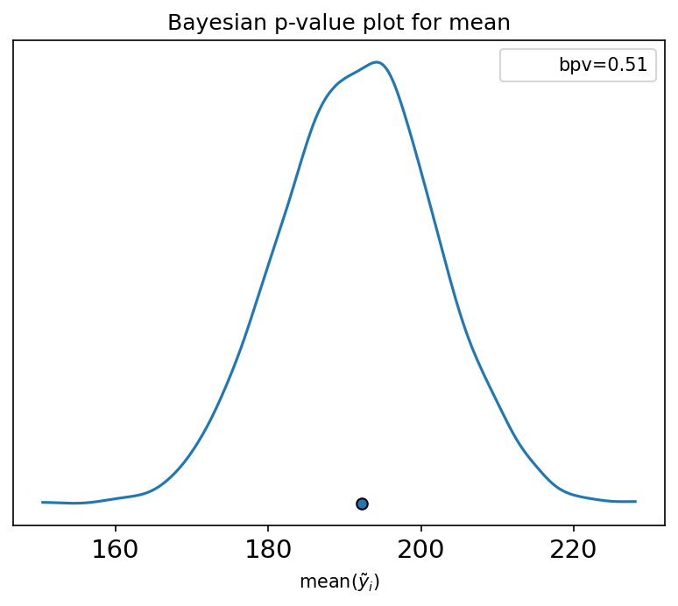
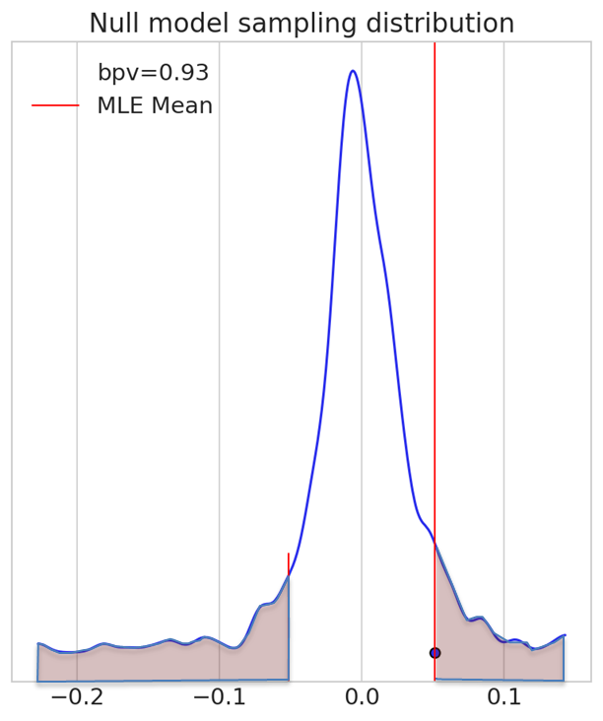


Frequentist p value is like Bayesian p value
Bayesian p value
Frequentist p value
Calculate using posterior
To test model fit
Succeed if $p≈0.5$
Calculate using a prior
Sharp around a null model
To reject the null model
Succeed if $p<0.05$

Slide 39
8F The Confidence Interval

Slide 40
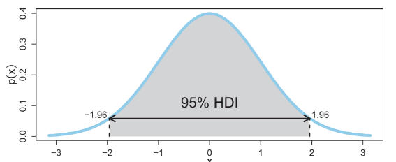
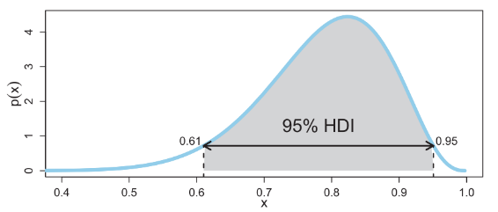
Review of Bayesian HDI
An interval of largest values that contains 95% of the probability

Slide 41
Frequentist intervals
Our goals:
Put a bound on the true value of the parameter
An estimate is not enough
Keep within the philosophy
The parameter is not a random variable
Priors introduce evil subjectivity
The solution:
Use the sampling distribution of the estimator

Slide 42
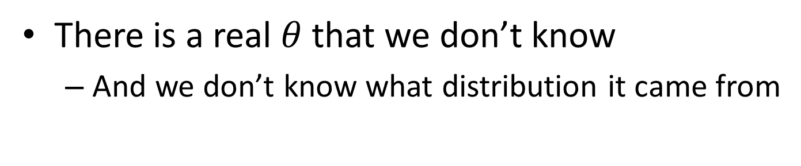
Creating a confidence interval
There is a real $θ$ that we don’t know
And we don’t know what distribution it came from
with pm.Model() as true_parameter_model:
theta = pm.Beta("theta", alpha=alpha_value, beta=beta_value)
prior_predictive = pm.sample_prior_predictive(samples=1, random_seed=123)
true_theta = prior_predictive.prior["theta"].item()

Slide 43
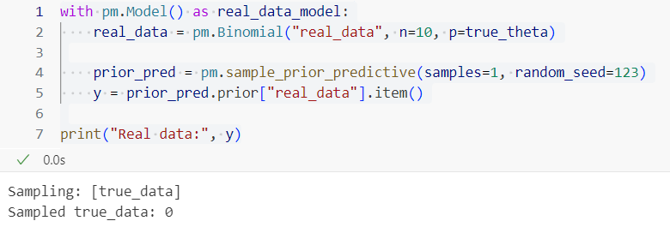
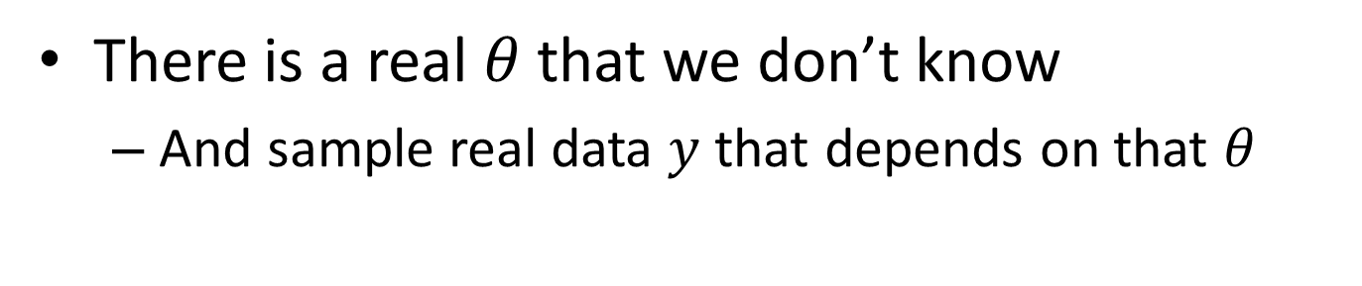
Creating a confidence interval
There is a real $θ$ that we don’t know
And sample real data $y$ that depends on that $θ$

Slide 44
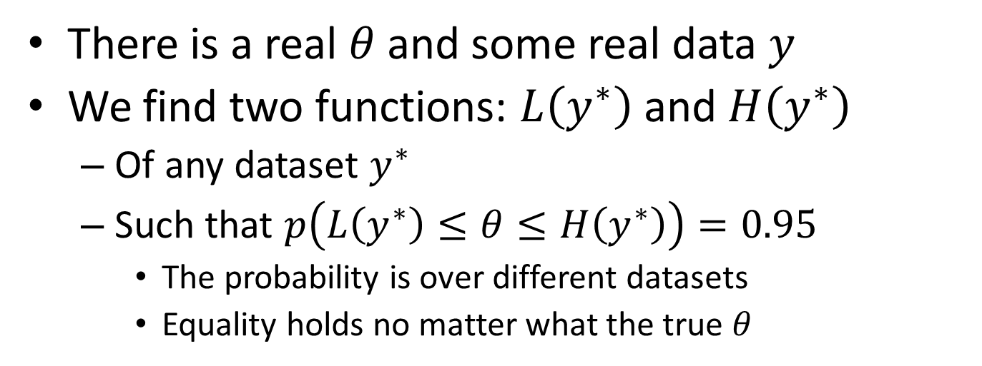
Functions with coverage
There is a real $θ$ and some real data $y$
We find two functions: $L\left(y^{∗}\right)$ and $H\left(y^{∗}\right)$
Of any dataset $y^{∗}$
Such that $p\left(L\left(y^{∗}\right)≤θ≤H\left(y^{∗}\right)\right)=0.95$
The probability is over different datasets
Equality holds no matter what the true $θ$

Slide 45
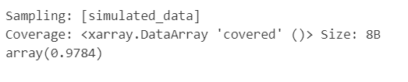
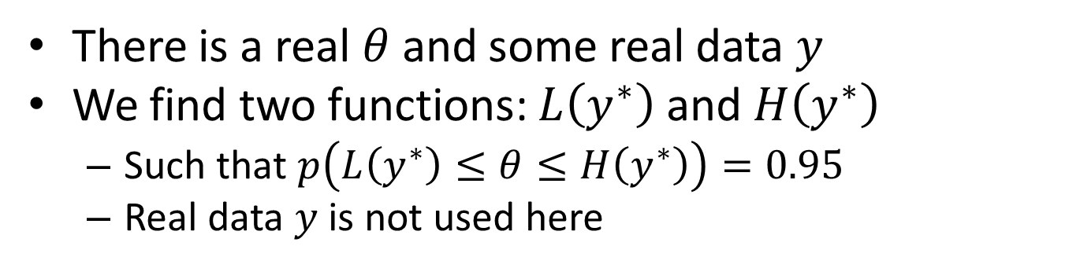
Testing coverage
There is a real $θ$ and some real data $y$
We find two functions: $L\left(y^{∗}\right)$ and $H\left(y^{∗}\right)$
Such that $p\left(L\left(y^{∗}\right)≤θ≤H\left(y^{∗}\right)\right)=0.95$
Real data $y$ is not used here
with pm.Model() as test_confidence_interval_model:
simulated_data = pm.Binomial("simulated_data", n=n, p=true_theta)
# Confidence bounds
L, H = symbolic_LH(simulated_data)
# Coverage indicator
covered = pm.Deterministic("covered", (L <= true_theta) & (true_theta <= H))
# Sample from the model
prior_pred = pm.sample_prior_predictive(samples=5000, random_seed=123)
coverage = prior_pred.prior["covered"].mean()
print("Coverage:", coverage)

Slide 46
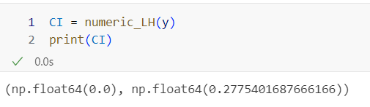
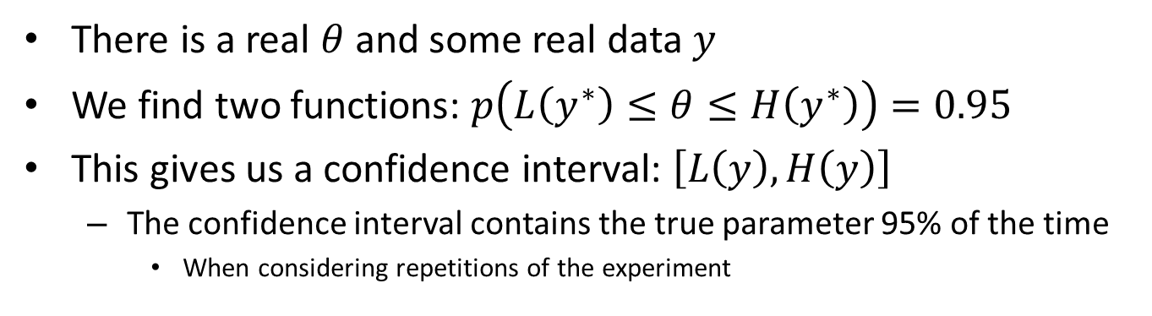
Coverage functions define confidence interval
There is a real $θ$ and some real data $y$
We find two functions: $p\left(L\left(y^{∗}\right)≤θ≤H\left(y^{∗}\right)\right)=0.95$
This gives us a confidence interval: $\left[L\left(y\right),H\left(y\right)\right]$
The confidence interval contains the true parameter 95% of the time
When considering repetitions of the experiment

Slide 47
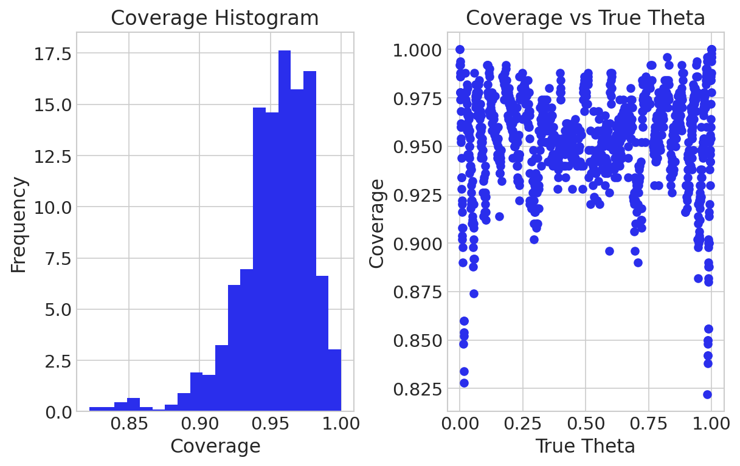
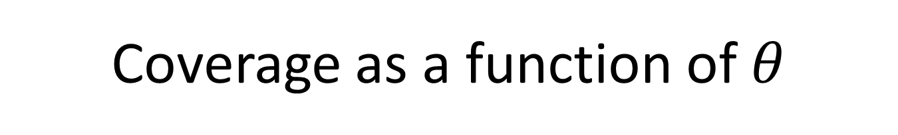
Coverage as a function of $θ$
Confidence interval can be noisy

Slide 48
Confidence interval visualization
https://rpsychologist.com/d3/ci/

Slide 49
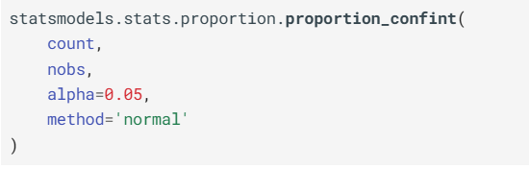
Functions to calculate confidence intervals
No need to worry about how it’s calculated

Slide 50
8G Interpreting the Confidence Interval

Slide 51
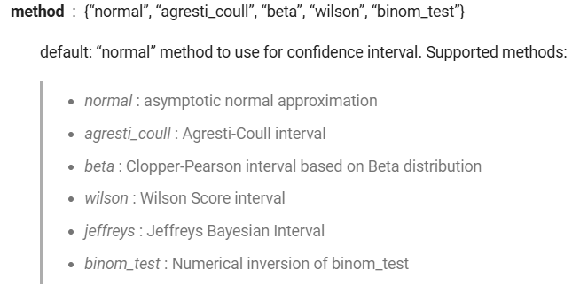
More than one confidence interval
Different methods with different assumptions

Slide 52
Misinterpretations of CI in literature
Ascribing probability to a parameter is misusing the CI
“There’s a 95% chance the true parameter is in this interval.”
“This CI tells me where the parameter is most likely to be.”
“This CI means the null model is likely / unlikely.”

Slide 53
Credible intervals
Generic term for both HDI and CI
An interval where you think the parameter should be
Intervals are often similar
For simple models
And enough data

Slide 54
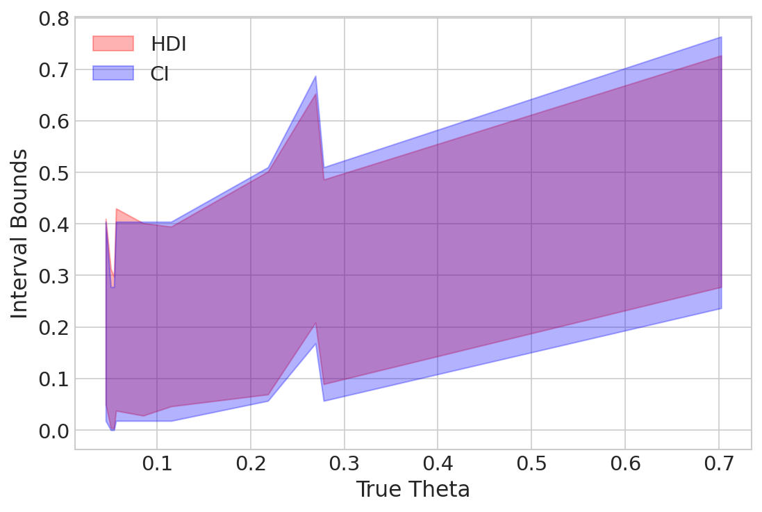
HDI vs CI
This is for samples of size 10

Slide 55
8G Frequentist Regression

Slide 56
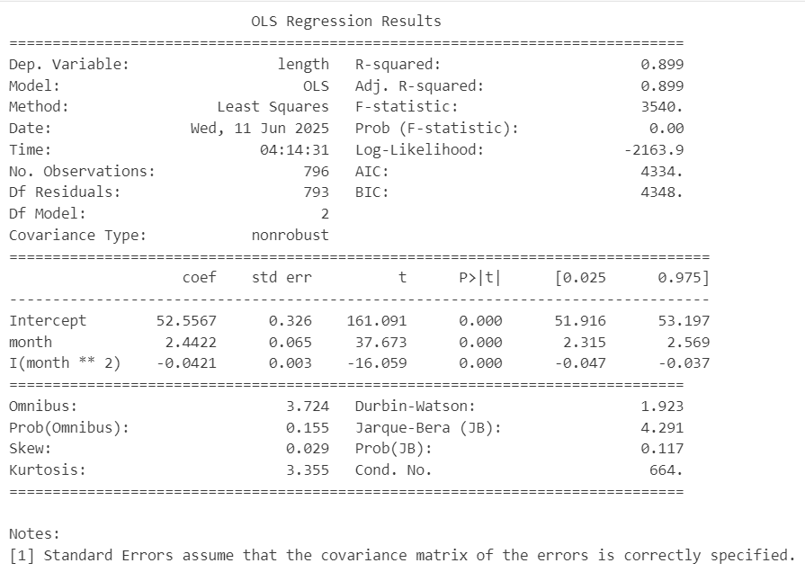
Frequentist Regression
Regressing baby length on months of age
model_frequentist = smf.ols("length ~ month + I(month**2)", data=babies).fit()
print(model_frequentist.summary())

Slide 57
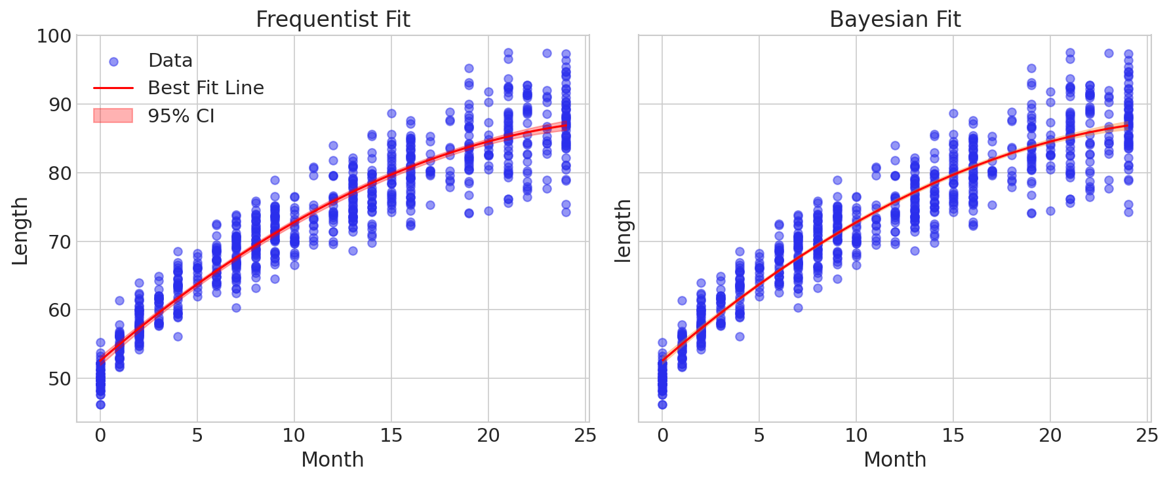
Frequentist Regression
Regressing baby length on months of age
model_frequentist = smf.ols("length ~ month + I(month**2)", data=babies).fit()

